Slide 1
Data Pre-processing and Exploration
Practical Course • 2 Credits • 60 Hours
Python • Pandas • Matplotlib • Seaborn • Scikit-learn

Slide 2
Learning Objectives
Load and inspect CSV datasets using Pandas.
Identify and handle missing values, inconsistent formatting, and outliers.
Calculate descriptive summary statistics.
Create univariate and bivariate visualizations.
Identify features and target variables.
Apply label encoding, scaling, standardization, and binarization.

Slide 3
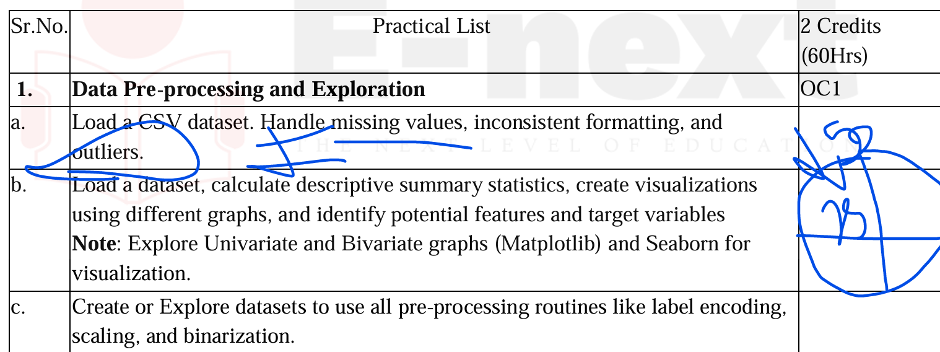

Slide 4

Practical 1(a): Load and Clean a CSV Dataset
Aim: Perform basic data cleaning on a student performance dataset.
Dataset fields: Roll_No, Name, Age, Gender, Marks, Attendance.
Tasks: load data, inspect rows/columns, find missing values, correct formatting, and detect outliers.
Expected outcome: a clean and analysis-ready dataset.

Slide 5
Sample Student Dataset
Roll_No | Name | Age | Gender | Marks | Attendance
101 | Amit | 18 | Male | 85 | 92
102 | Priya | 18 | Female | 90 | 95
103 | Rahul | 19 | Male | NaN | 88
104 | Sneha | 18 | female | 78 | 90
105 | Karan | 19 | Male | 150 | 85 ← possible outlier
106 | Neha | NaN | Female | 82 | NaN

Slide 6
Loading and Inspecting the Dataset
import pandas as pd
df = pd.read_csv("student_performance.csv")
print(df.head())
print(df.shape)
print(df.info())
print(df.isnull().sum())

Slide 7
df["Marks"] = df["Marks"].fillna(df["Marks"].mean())
df["Age"] = df["Age"].fillna(df["Age"].median())
df["Attendance"] = df["Attendance"].fillna(
df["Attendance"].mean()
)
Handling Missing Values
Missing values can occur because data was not entered, recorded, or collected.
Common methods: mean, median, mode, or a suitable fixed value.
For numerical data, mean or median can be used depending on the dataset.
Always check the result after filling missing values.

Slide 8
Inconsistent Formatting and Outliers
df["Gender"] = df["Gender"].str.capitalize()
# Basic range check
outliers = df[(df["Marks"] < 0) | (df["Marks"] > 100)]
print(outliers)
Inconsistent formatting: values such as 'female' and 'Female' represent the same category.
Standardize text values before analysis.
An outlier is a value that is unusually far from the other observations.
Example: Marks = 150 is suspicious when the normal mark range is 0–100.

Slide 9

Practical 1(b): Descriptive Statistics
print(df.describe())
print("Mean:", df["Marks"].mean())
print("Median:", df["Marks"].median())
print("Mode:", df["Marks"].mode()[0])
Aim: Calculate summary statistics and understand the dataset.
Mean – average value.
Median – middle value after sorting.
Mode – most frequently occurring value.
Minimum and Maximum – smallest and largest values.
Standard deviation – shows the spread of values.

Slide 10
import matplotlib.pyplot as plt
import seaborn as sns
plt.hist(df["Marks"], bins=5)
plt.xlabel("Marks")
plt.ylabel("Students")
plt.title("Distribution of Marks")
plt.show()
sns.boxplot(x=df["Marks"])
plt.title("Marks - Box Plot")
plt.show()
Univariate Visualization
Univariate analysis studies one variable at a time.
Histogram – shows the distribution of numerical data.
Box plot – helps identify spread and possible outliers.
Bar chart – compares categories or individual values.
Pie chart – shows proportions of categories.

Slide 11
Bivariate analysis studies the relationship between two variables.
Scatter plot: useful for two numerical variables.
Example: Attendance vs Marks.
The graph can help identify patterns, trends, or unusual observations.
Bivariate Visualization
sns.scatterplot(
x="Attendance",
y="Marks",
data=df
)
plt.title("Attendance vs Marks")
plt.show()

Slide 12
Features are input variables used to make an analysis or prediction.
Target is the variable we want to understand or predict.
Example features: Age, Gender, Attendance.
Example target: Marks.
The choice depends on the purpose of the dataset.
Features and Target Variable

Slide 13
Aim: Transform raw data into a form suitable for analysis or machine learning.
Label Encoding converts categories into numerical labels.
Min-Max Scaling converts values to a specified range, commonly 0 to 1.
Standardization transforms values around mean 0 with standard deviation 1.
Binarization converts values into 0 or 1 using a threshold.
Practical 1(c): Data Pre-processing

Slide 14
Label Encoding
from sklearn.preprocessing import LabelEncoder
le = LabelEncoder()
df["Gender_Encoded"] = le.fit_transform(df["Gender"])
print(df[["Gender", "Gender_Encoded"]])

Slide 15
Scaling and Standardization
from sklearn.preprocessing import MinMaxScaler
from sklearn.preprocessing import StandardScaler
minmax = MinMaxScaler()
df["Marks_Scaled"] = minmax.fit_transform(
df[["Marks"]]
)
standard = StandardScaler()
df["Marks_Standardized"] = standard.fit_transform(
df[["Marks"]]
)

Slide 16
Binarization
Binarization converts numerical values into two classes: 0 and 1.
A threshold is selected.
Example: threshold = 75.
Marks below the threshold become 0; marks at or above it become 1.
from sklearn.preprocessing import Binarizer
binarizer = Binarizer(threshold=75)
df["Marks_Binary"] = binarizer.fit_transform(
df[["Marks"]]
)
print(df[["Marks", "Marks_Binary"]])

Slide 17
Complete Practical Checklist
1. Load the CSV dataset.
2. Inspect rows, columns, data types, and missing values.
3. Clean missing and inconsistent data.
4. Detect possible outliers.
5. Calculate descriptive statistics.
6. Create univariate graphs.
7. Create bivariate graphs.
8. Identify features and target.
9. Apply encoding and scaling techniques.
10. Save and report the cleaned/transformed dataset.

Slide 18
Suggested Datasets for Practice
Student Performance Dataset
Iris Dataset
Titanic Dataset
Employee Salary Dataset
House Price Dataset
Customer Sales Dataset

Slide 19
Practical Questions / Viva
What is data pre-processing?
Why are missing values handled?
What is an outlier?
What is the difference between univariate and bivariate analysis?
What is label encoding?
Why is feature scaling required?
What is the difference between Min-Max Scaling and Standardization?
What are features and target variables?

Slide 20
Conclusion
Data pre-processing improves the quality and consistency of raw data.
Exploratory analysis helps us understand patterns and relationships.
Visualization makes data easier to interpret.
Encoding and scaling prepare data for further analysis and machine learning.

